Slide 1
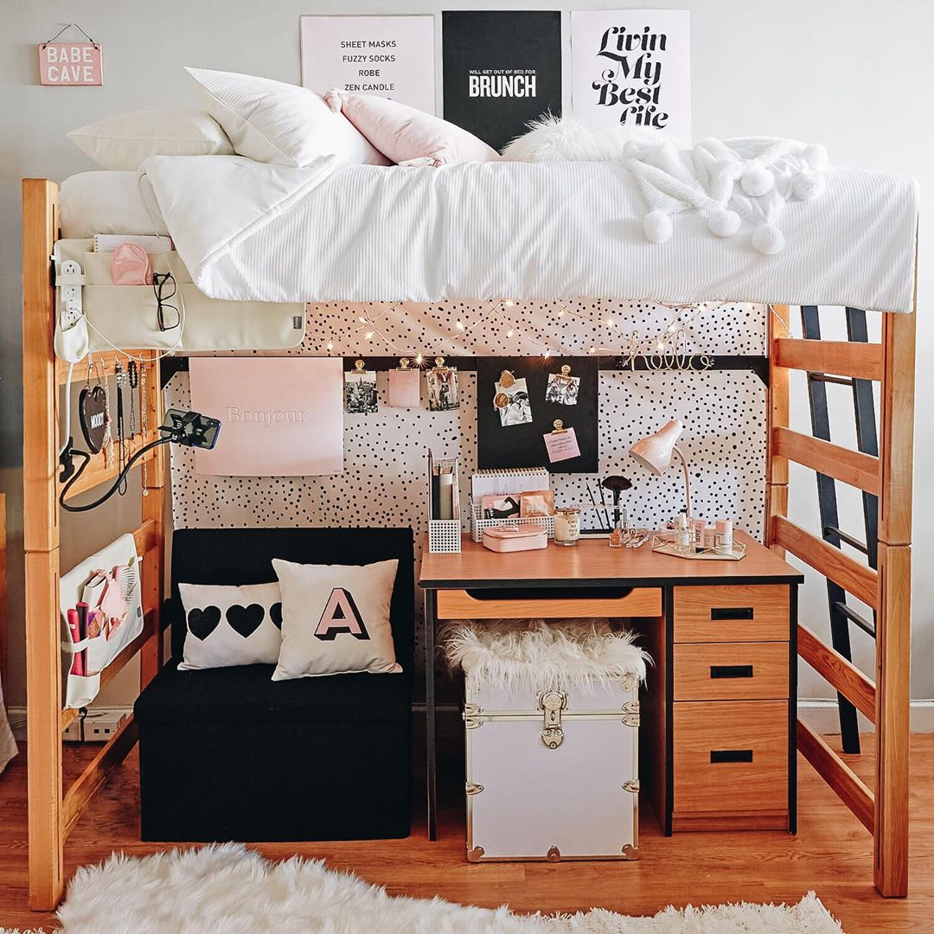
Campus
Essentials
Digital
Presence
Alina Gusick, Laura Hurley, Katrina Hook, Stephanie Bruin

Slide 2
Introduction
Provides must-have, non-tech products for college students
Meant to simplify and enhance students' daily lives
Offers a diverse range of essentials, including
  Stationery, bedding, storage solutions, and lifestyle products (such as décor and candles)
Tailored to meet the unique needs of college life

Slide 3
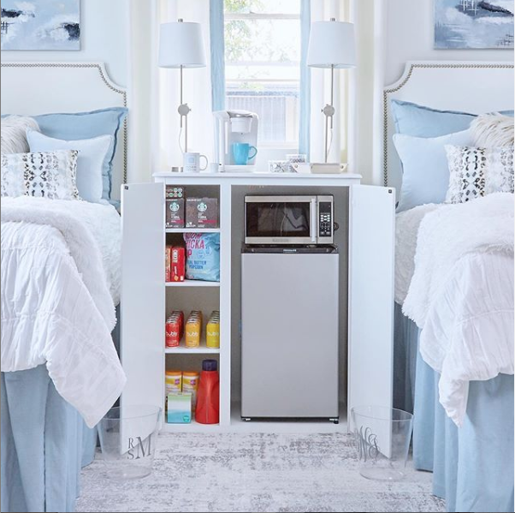
Stage 1: Marketing Overview
Core Values:
  Affordability
  Quality
  Convenience for college students
Unique Selling Points:
  Budget-friendly essentials
  Practical and stylish designs
  Commitment to simplifying the college experience

Slide 4
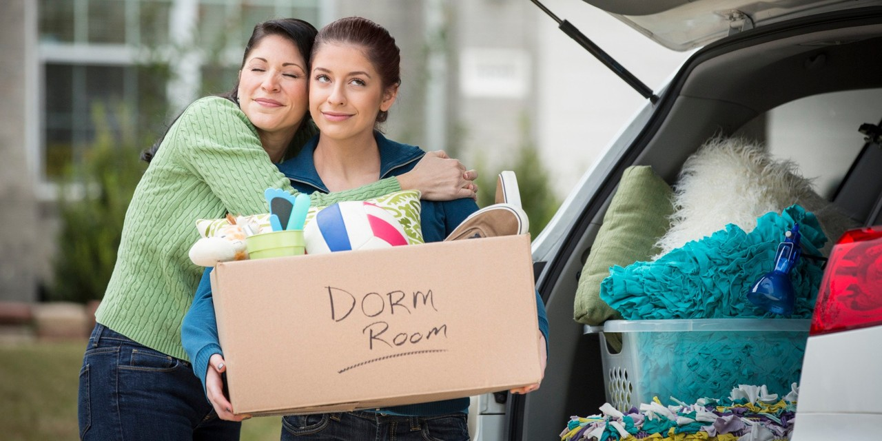
Target Market
Incoming and current college students
Parents of students
Gift shoppers

Slide 5
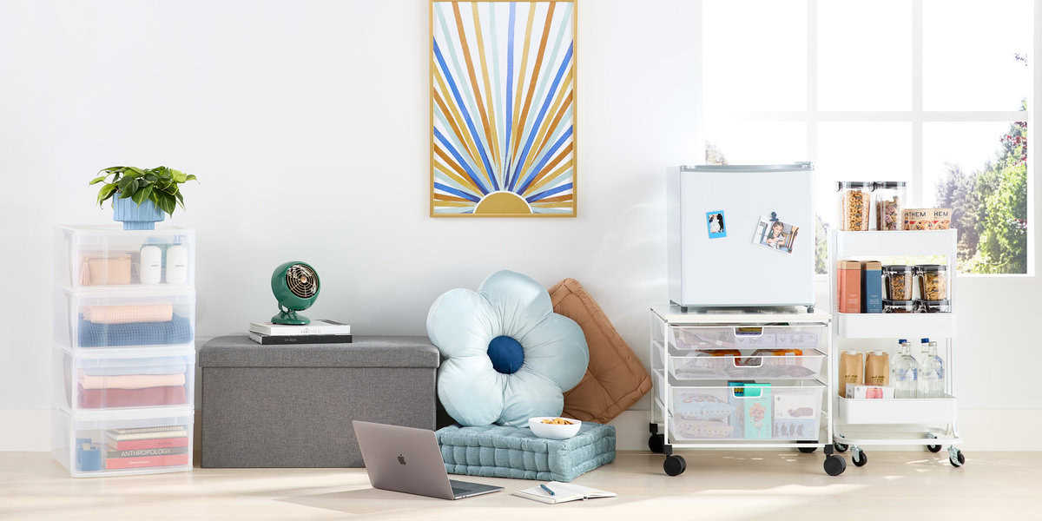
Consumer Needs and Values
Students value products that are:
Budget-friendly
Quality
Functional
Durable
Stylish

Slide 6
SWOT
Strengths
Focus on essential non-tech products Affordable Potential for practical viral marketing Ability to target college communities
Weaknesses
Initially limited brand recognition Competition from established brands
Opportunities
Increasing demand for budget-friendly essentials Potential to collaborate with college organizations
Threats
Decreasing college student population Evolving student preferences Economic downturn affecting purchasing power Potential supply chain disruptions

Slide 7
4Ps
Price
Keep products budget friendly Offer new customer 10% discount when signed up for emails and texts
Product
Stationery, bedding, storage solutions, and lifestyle products (such as décor and candles)
Place
Colleges & Universities
Promotion
Social Media Marketing Email Marketing Paid Advertising Search Engine Optimization

Slide 8
Digital Marketing Objectives
Increase online brand awareness by 25% within the next six months
Achieve a 15% growth in online sales through the official website

Slide 9
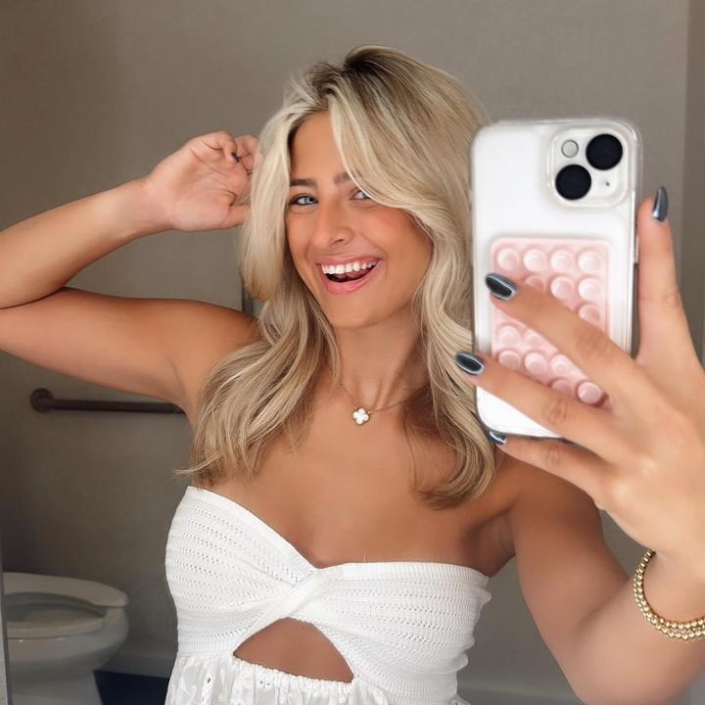
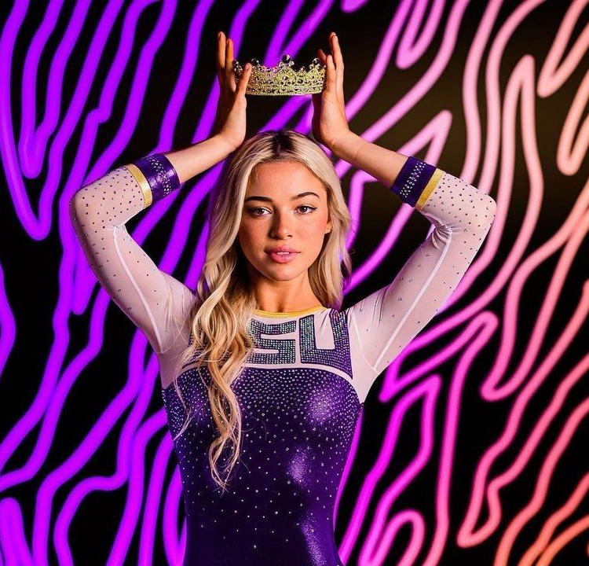
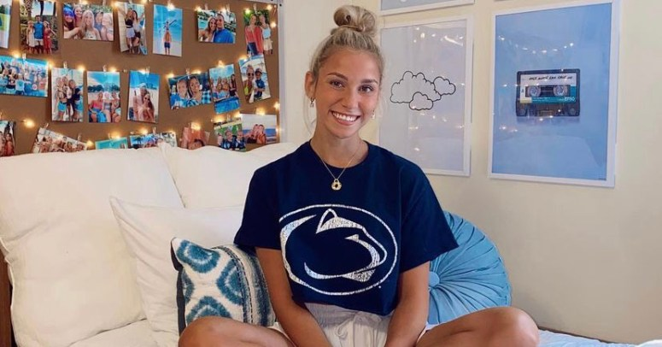
Social Media Marketing
Avery Katherine
  2.7 Millon TikTok Followers
  570K Instagram Followers
  19.5K YouTube Followers
Olivia Dunne
  8.1 Million TikTok Followers
  5.3 Million Instagram Followers
Katie Feeney
  7.6 Million TikTok Followers
  1.2 Million Instagram Followers
  3.77 Million YouTube Subscribers

Slide 10

Email Marketing
Partner with Susquehanna University Residence Life
  Send informational emails to ~2,200 students, similar to Storage Scholars
  Provide company information in initial email outreach to new students
  Monthly newsletters delivered to inboxes of students and parents with "trending" essentials
  Can expand approach to Residence Life Offices in schools across the country

Slide 11
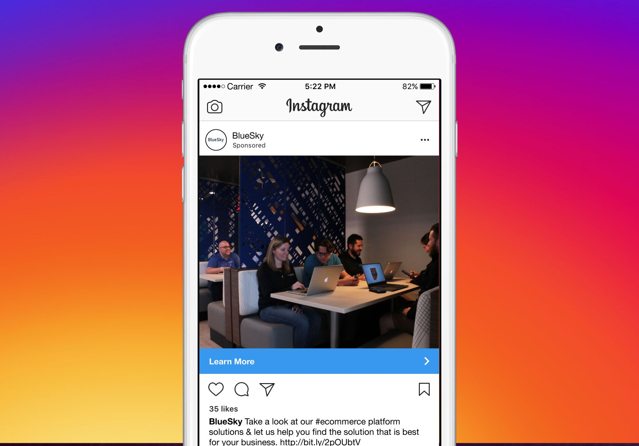
Paid Advertising
Clickable advertisements displayed on Instagram posts and stories
  Call-to-action buttons linked to products featured
  Features real-life orders and college customers
Promoted Facebook posts featuring parents with their children
  Call-to-action buttons linked to products featured
  Invoke emotions in parents and associate essentials with providing comfort

Slide 12

Search Engine Optimization
Primary months of search: May June July August
Work with search engines for top results (paid)
Keywords when searching:
  Dorm, dorm room, dorm essentials, college essentials, college room, college décor, room décor, bedding, college decorations

Slide 13
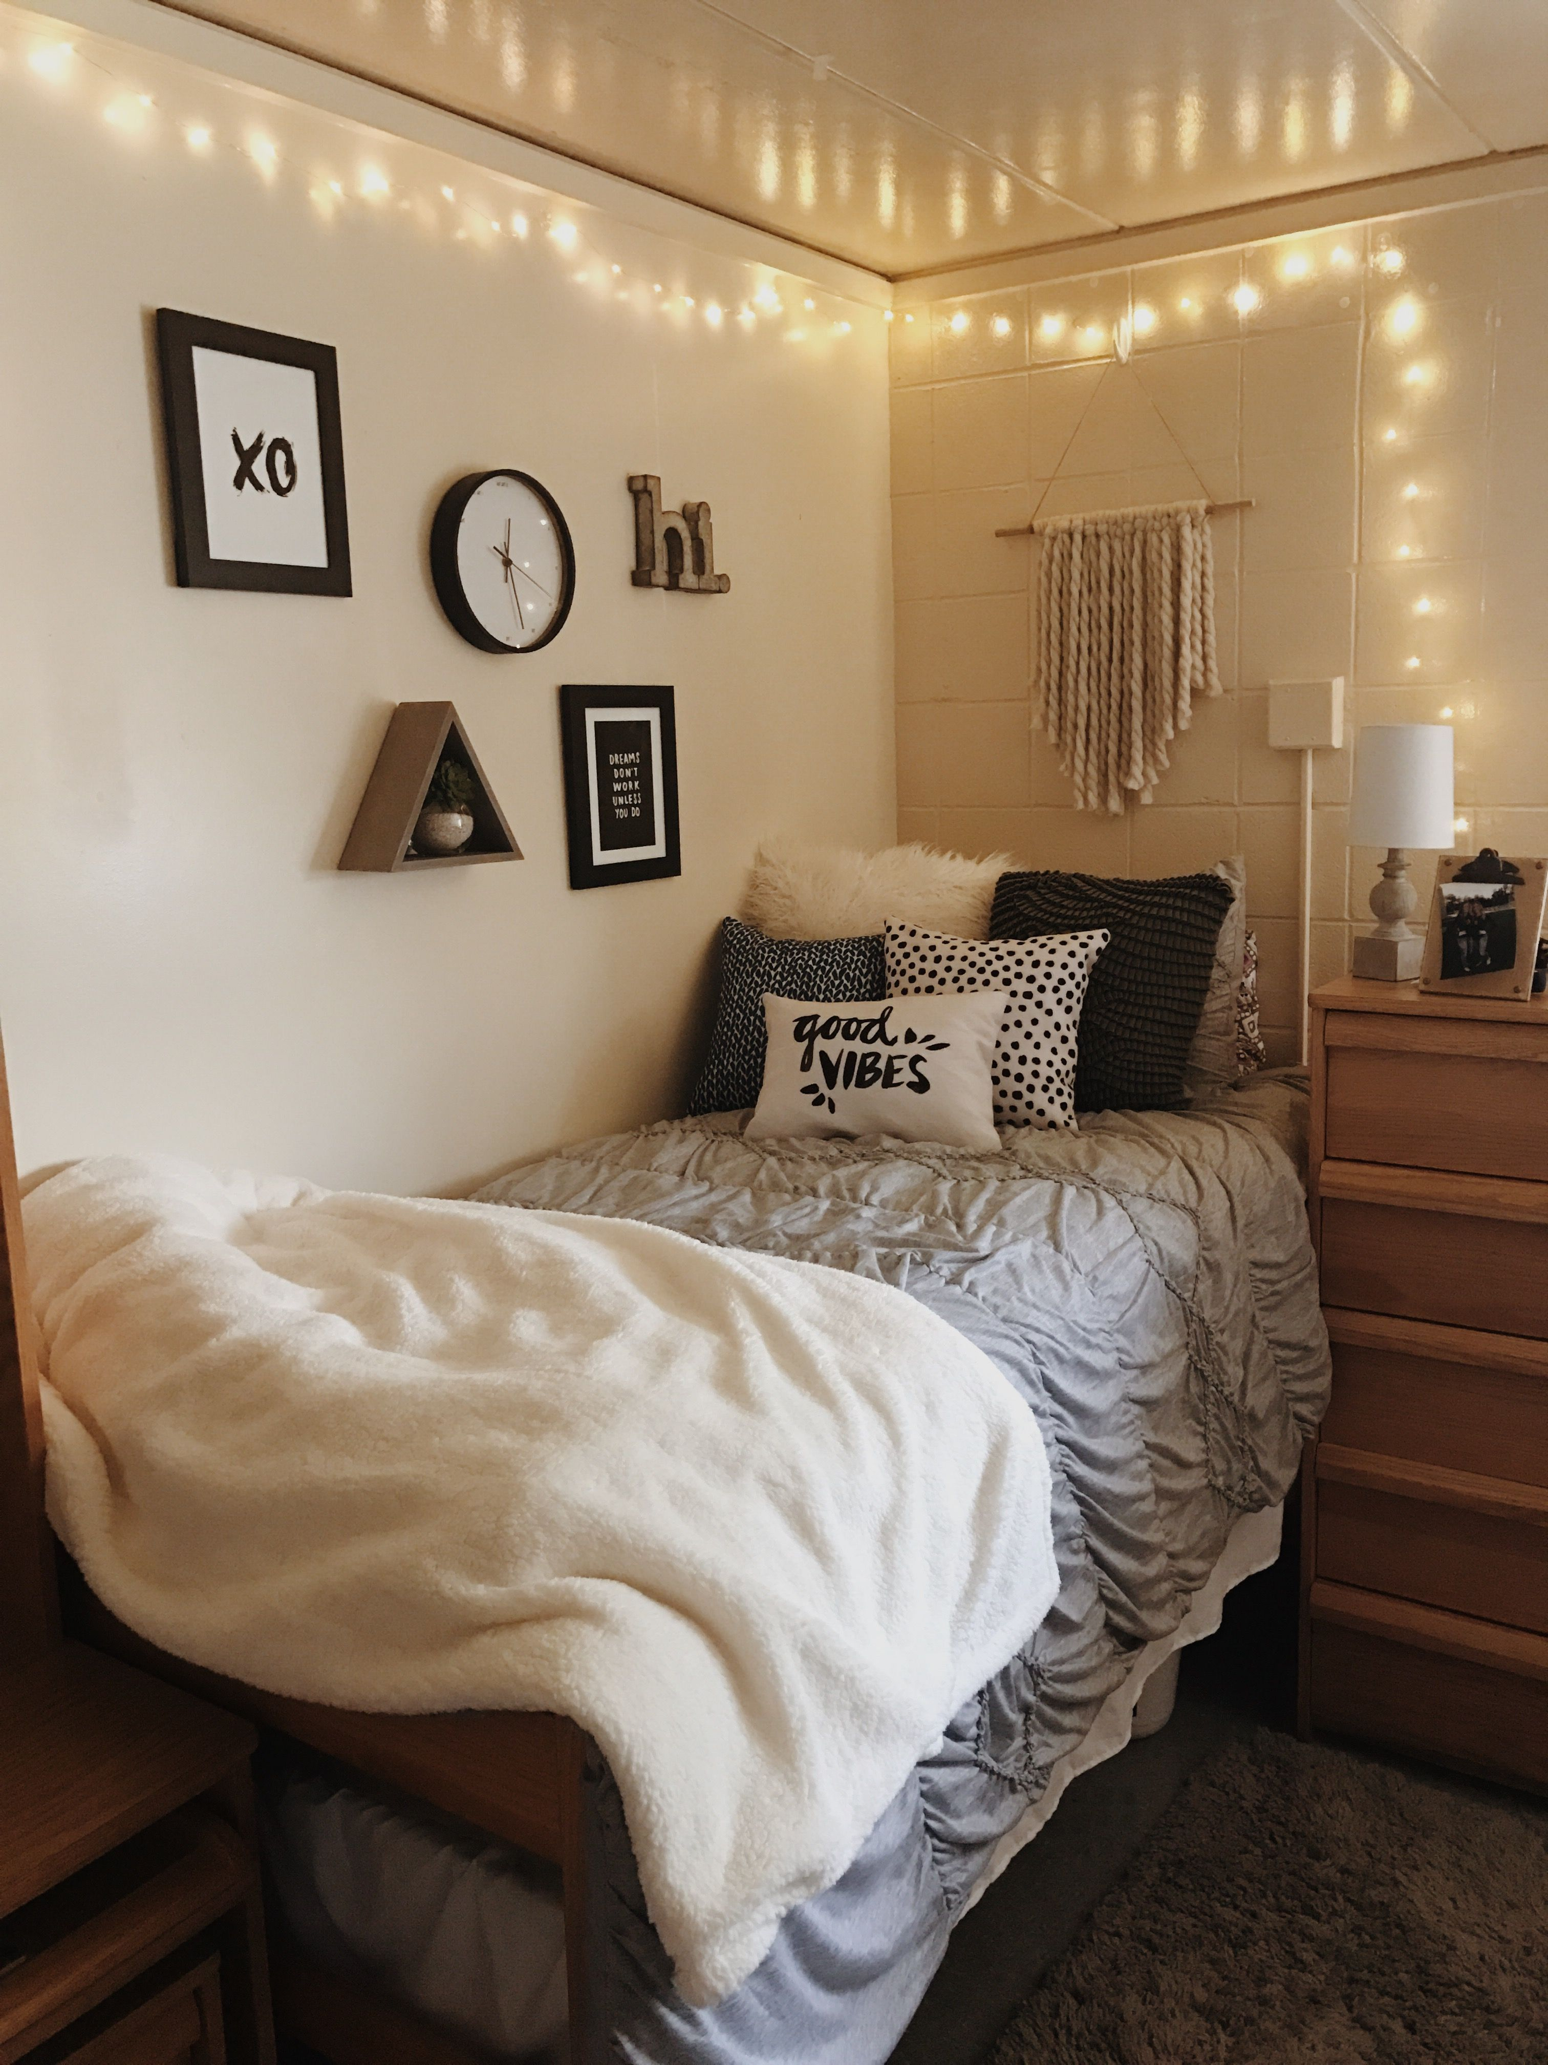
Outcomes
What do we want to accomplish with these marketing tools?
  Increase sales in college students and parents
  Create more brand awareness and accessibility
  Allow for online users to easily use the search engine

Slide 14
Thank You!

